Slide 1
The Marquee Console
Semi-MO – Immediate-mode Mockup
Marvin Ivan C. Mangubat

Slide 2
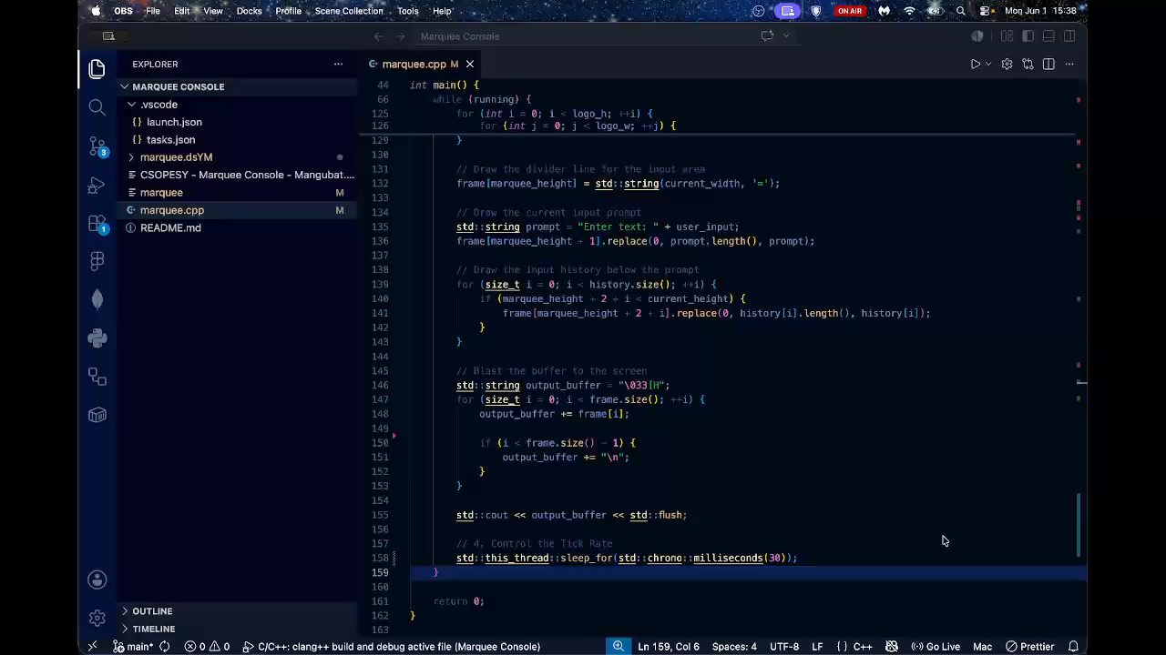
Video Demo

Slide 3
Recommended Values for My Current Hardware
The target tick rate for my hardware is a sleep duration of 8.3 ms to 33 ms, corresponding to approximately 120 Hz down to 30 Hz.
I derived the lower bound here (8.3 ms) from my display hardware as it matches the my laptop panel's 120 Hz refresh period, so every application frame aligns with one monitor frame and the animation is smooth. The upper bound (33 ms / 30 Hz), on the other hand is the ceiling of practical usability, as below that threshold, the while(kbhit()) drain fires frequently enough that normal typing speeds (~300 ms between keystrokes) are always captured within a single sleep window, which keeps the input response not perceivable. Beyond 33 ms, however, the gap becomes noticeable during faster typing.
This range therefore satisfies both constraints simultaneously as the animation of the ASCII art remains visually fluid, while the polling window stays small enough that the input drain is near instant relative to what we can perceive.

Slide 4
Identifying the Limits
My implementation of the marquee loop's sleep_for() call serves as both the render timer and the keyboard polling interval so there is no separate input thread. This creates two observable failure modes at extreme ends.
At the high end of the spectrum, when we push the sleep duration above ~100 ms, it introduces noticeable input latency. The select()/read() drain only fires when the loop wakes up, so the keystrokes that arrive during the sleep window just pile up in the OS buffer. When I tried it out, I perceived it as quite sluggish with delayed character recognition. The CLI feels unresponsive and laggy.
At the low end of the spectrum, using a 1 ms sleep duration, the application's logical tick rate outpaces my display's maximum 120 Hz refresh rate. The vector updates multiple times per physical frame, resulting in an artificially accelerated, hyper-fast animation.

Slide 5
Absence of Tearing
From what I learned online, in a conventional Unix terminal or a legacy console, running the loop at 0 ms sleep (which is the maximum CPU speed) would produce visible screen tearing where the monitor's scan captures only a partially-written frame. My implementation did not exhibit that artifact even at maximum tick rates.
I believe that the reason for this is the macOS WindowServer compositor. The terminal's output is not written directly to the framebuffer because it is rendered into a virtual buffer managed by the OS. The WindowServer enforces system-wide V-Sync and double-buffering, committing swaps to the physical display at a ceiling of 120 Hz (based on my hardware max). No matter how fast the application writes to that virtual buffer, the display only presents complete frames at the hardware refresh boundary, which masks the partial-write artifacts that cause tearing in environments without a compositor layer.

Slide 6
End of slides

